Slide 1
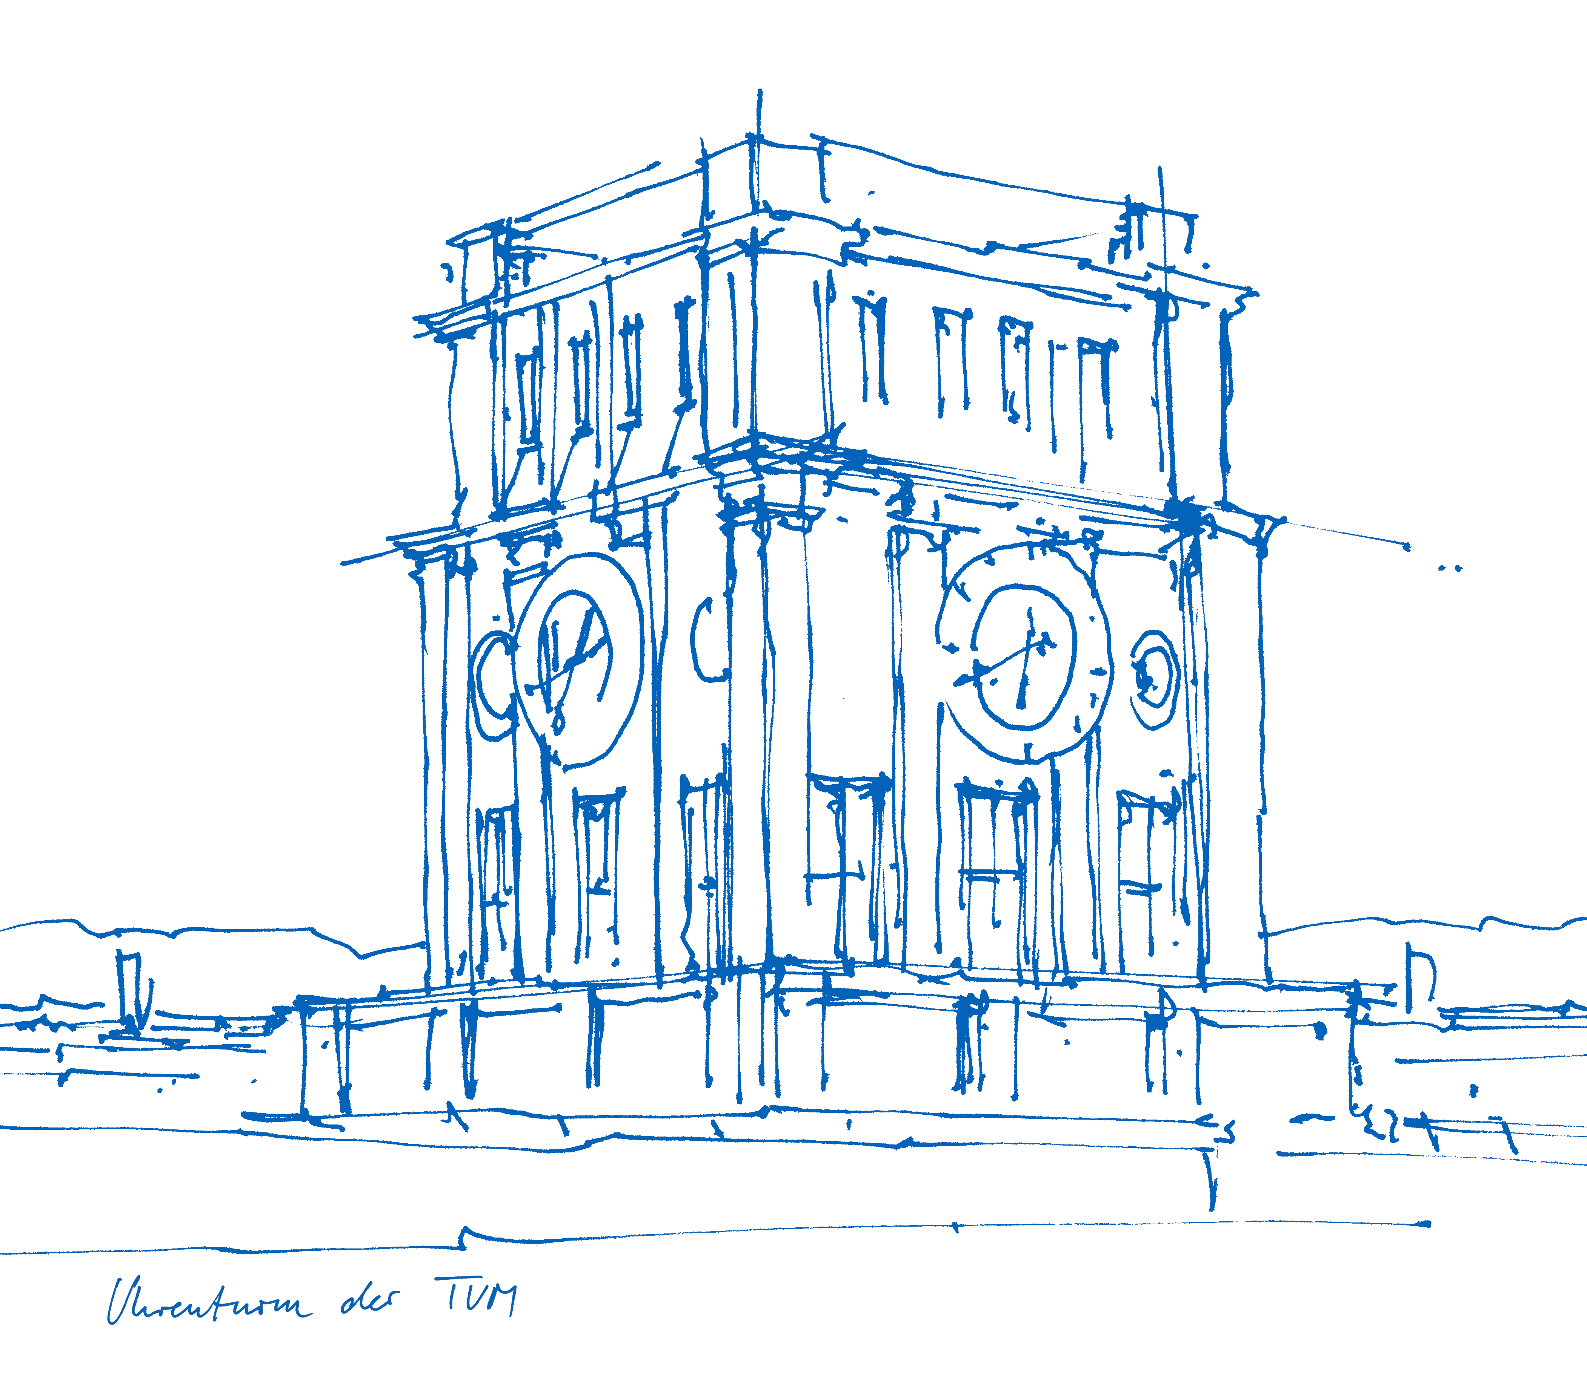
Exploring near-cost optimal alternatives for an intertemporal model of the German power system
Ilsu Kazkayasi
Technical University of Munich
Munich, 06 April 2020
Midterm Presentation Master's Thesis
Supervisor: Soner Candas

Slide 2
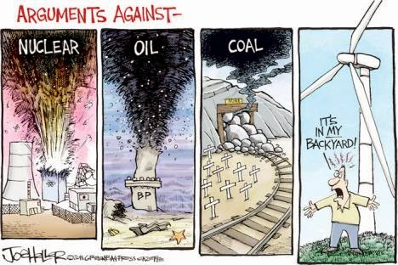
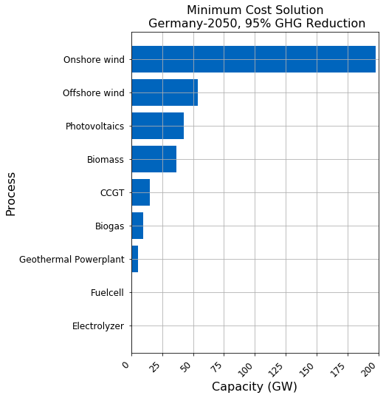

What is the point?
Notes:
First I want to start with motivation of my study
Why it worths studying this topic, what is the point
Classical cost optimization of an energy system returns a single cost optimal solution.
However long term investment decisions of an energy systems can not be made purely cost driven
There are many other criterias that remain uncaptured by the model
For example, social acceptance, scale of infrastructure projects, complexity and scale of the system itself,
Those criterias can be counted as structural uncertainties of the model
In addition to that, input parameters to the model are highly uncertain by nature
Long term prediction of Cost of technologies, fuel prices, load profile
As an end effect ,Real world transitions are usually more costly than modelled cost optimal solutions
For these reasons it is important to analyse near cost optimal alternatives of an energy system.
But what exactly near cost optimal alternatives mean?

Slide 3
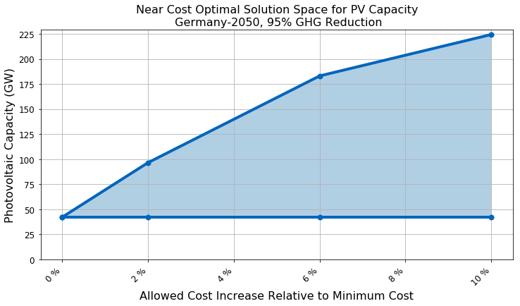
Near cost optimal alternatives
Notes:
- Near Cost Optimal alternatives are similar costly but sub cost optimal alternative solutions to cost optimal solution.
- In my study I utilize Modelling to Generate Alternatives methodology to study near optimal space of German power system.
In this methodology cost optimal solution is used as an anchor point to explore the surrounding decision space
In this graph this point is PV capacity given by the cost optimal solution as we diverge from cost optimum we see investment flexibility increases. 2% cost increase gives almost 50 GW flexibility in PV capacity investment
MGA is good for
Observing technologically diverse but similar costly solutions
Offers alternative transition pathways to meet unmodelled criteria like social exceptance for example
Evaluate the stability of cost optimal solution, here we see offered PV capacity by cost optimum solution is not stable at all
Show persistent long term investment decisions,
Now as we discussed about the methodology applied lets talk about the novel point.
What is the novel point of this study?

Slide 4
What is the novel point?
Studies that apply modeling to generate alternatives (MGA) to energy system models.
Notes:
Here you see a list of studies that apply modeling to generate alternatives (MAG) to energy system models.
To my knowledge, my study is the first to utilize MGA for an intertemporal model of German power system.
I am going to analyze the period from 2020 to 2050 with total of 4 different modelled years.
The model will also consider progressive GHG mitigation goal defined by the German authorities.
To put it in one sentence
Goal of my thesis is to explore near-optimal, intertemporal investment alternatives to German power system model while sticking to long term emmission goals of Energiewende.
- Now probably you are asking yourselves what is the deal with intertemporal?

Slide 5
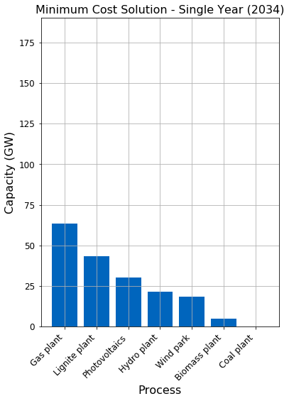
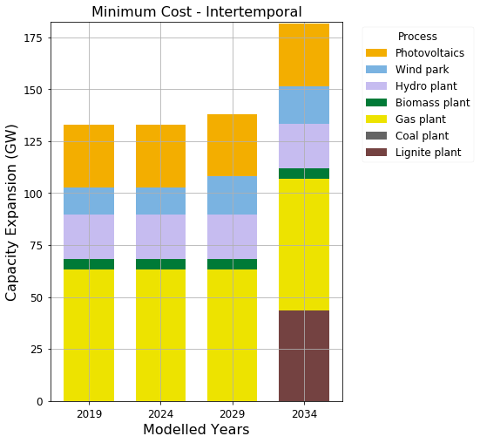
What does an Intertemporal model mean?
Notes:
Well, Intertemporal models analyse the development of the power system through a modeling horizon.
They give the solution as snapshots of the transition across multiple years
And plus they consider the investment dependencies between modelled years
On the left side you see a single year solution, which gives cost optimum for 2034
On the right side you see intertemporal solution of same input file with 4 different moddelled years from 2019 to 2034.
In the latter it is possible to observe how the transition will look like through years.
Also it is possible to define a cummulative co2 budget instead of a specific limit for single years.
As we are finished with terminology lets take a look at the application procedure

Slide 6
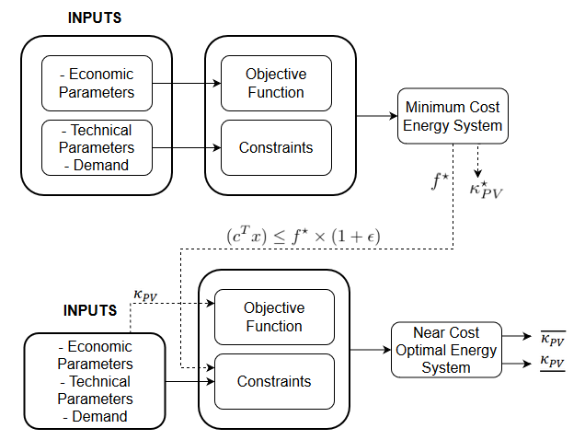
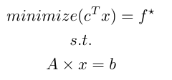
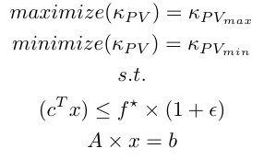
Application
Notes:
I applied MAG on „URBS“ , which is a linear energy system modelling framework
URBS already has working intertemporal modules,
however it is originally capable of doing only classical optimization.
In order to apply MAG with urbs I created an independent module that analyses near cost optimal alternatives
Which first runs the model with a classical cost optimization.
Minimum cost found is applied to the model as a new constraint with a small percentage increase
A set of generation capacities are choosen to be objected to optimization , here only PV capacity is choosen but program is designed to accept also more than one
A new objective function is formulated to first maximize then minimize objected generation capacities
As outcome a range of capacity is obtained for the same cost
Some other capabilites of the new feature:
It takes a list of slack values and applies them in succession automatically
For multi node models it is possible to choose optimization regions independently for each optimized generation technology.
Region selection made available also for the original objectives
----------------------
Now it is time to see the first results ☺

Slide 7
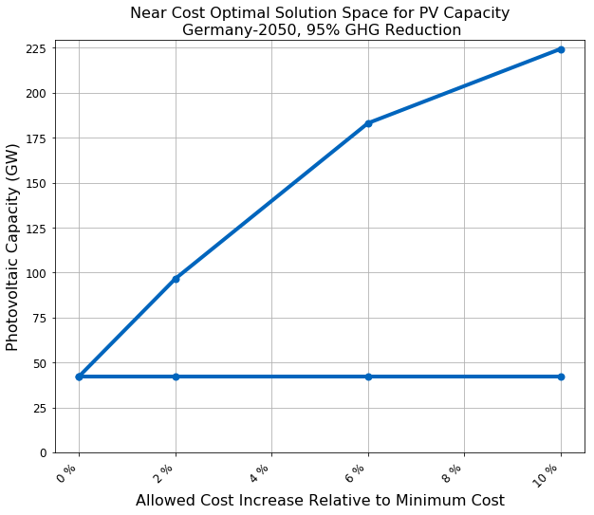
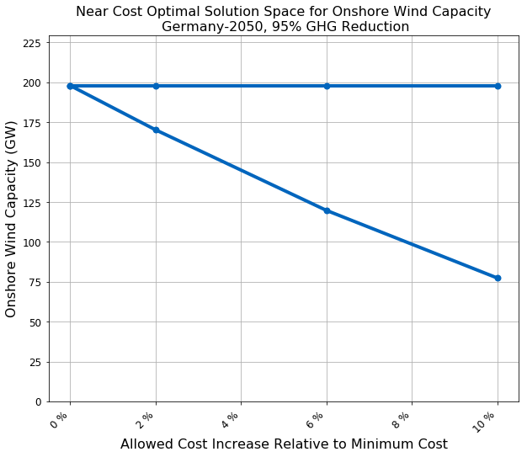
Results – Germany, Single Year, 2050
Notes:
I have the input file for 2050 German power system from a former student‘s master Thesis
I analyzed this input file with my new module
In the first graph PV generation capacity is subjected to optimization
and in the second graph onshore wind capacity is subjected to optimization
As we see ,
for current ghg mitigation goals, it is not possible to imagine a power system for germay without onshore wind.
However as we diverge from the minimum cost, investment flexibility of technologies improves drastically.
PV capacity has a greater range of flexibility as also pointed out by other similar studies

Slide 8
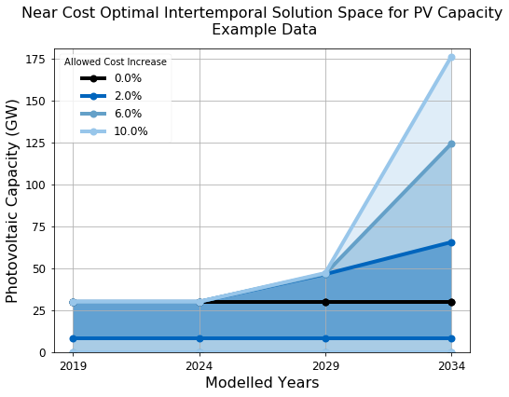
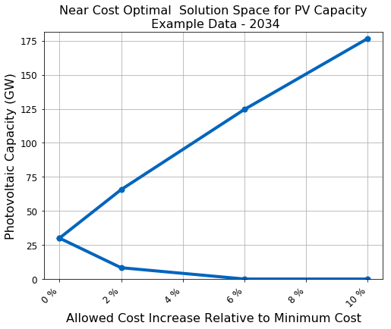
Results – Intertemporal Example from GitHub
Notes:
Here is an intertemporal solution for the example input files from git hub repository
On left side solution for a single year (2034) is shown
on the right side you see the intertemporal solution for the same input file
development of the solution through years can be observed in the letter.
Shaded areas are capacity ranges offered by different cost increase allowences
These graphs show only the capacity of the pv generation technology

Slide 9
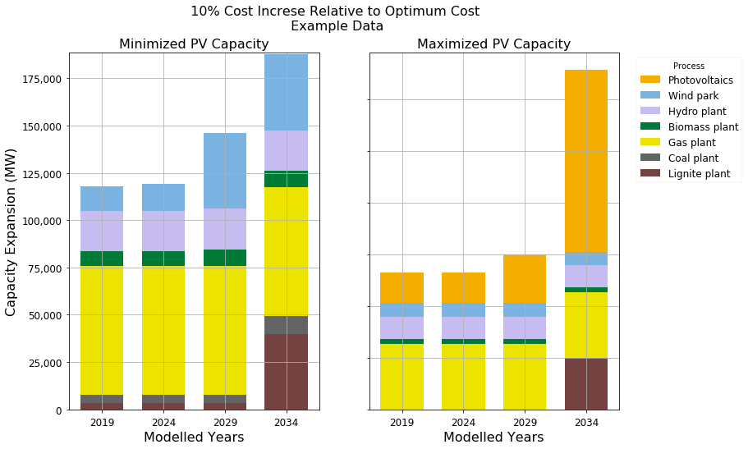
Results – Flexibility of the system
Notes:
- Here is another view of the same intertemporal solution
- this time only for 10 percent cost increse
- On the left side you see how system will evolve when pv capacity is subjected to minimization
On the right side PV capacity is subjected to maximization
- Here we can interpret that wind energy and PV are substitutes of each other
- Minimization of one will cause increase of the other due to ambitious GHG reduction goals.
- It is also clear that two solutions looks largely different from each other, however they have same costs and they are for same set of input parameters

Slide 10
Next steps…
Input File for 2020 and 2050
Interpolation for 2030 and 2040
Runing for entire time horizon and multiple cost increases
Interpretation of results
Documentation of near optimal feature as a new module for urbs
Notes:
Lastly I want to talk about the next steps I plan to achieve during course of my thesis

